Slide 1
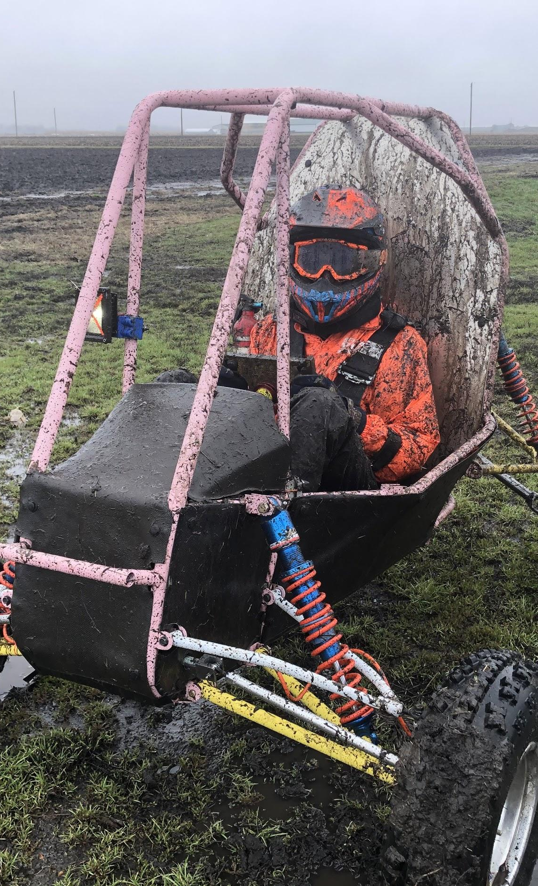

ME 199
4/13/20

Slide 2
Announcements
Working on design slides
Competition delivery platform is still unknown
SAE Updates
Each team competes only once
Individual competition scores are the same, but we’re compared to that specific competition’s pool of teams
But we still don’t get money back :/
4WD project assignments coming out in the next week

Slide 3
Due Dates
Last Friday (4/10): Wiki updates done and uploaded
Thank you to those of you that completed them on time!!
Keep an eye out if we ask you to add anything to your page
Friday April 17: FMEA
Check your sub-team channel for message from Becca
FMEA = Failure Modes and Effects Analysis
NOT the same as your wiki page

Slide 4
Subteam Updates

Slide 5
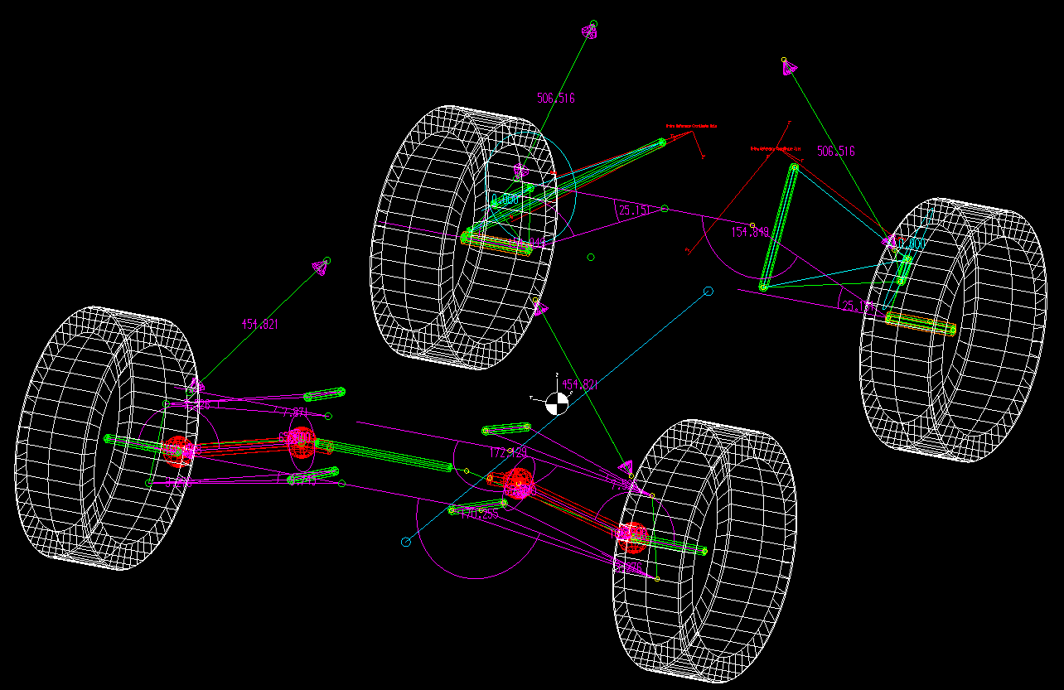
Suspension
Wednesdays at 3pm
Zoom Meeting
199 projects due Wednesday!
Wrapping up all Jill work
Fill out 4WD project interest form ASAP!
Project assignments this week
4WD suspension points Iteration 1 coming out by the end of the month
Part design starting early

Slide 6
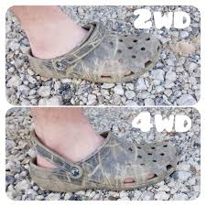
Drivetrain
Wednesdays at 7pm
Zoom Meeting
Slides sent out tomorrow, fill out your sections for Wednesday
4WD project interest coming soon
Sorry for the delay - Adam
Transition into 2021 leadership this week
Esmee is now your subteam lead

Slide 7
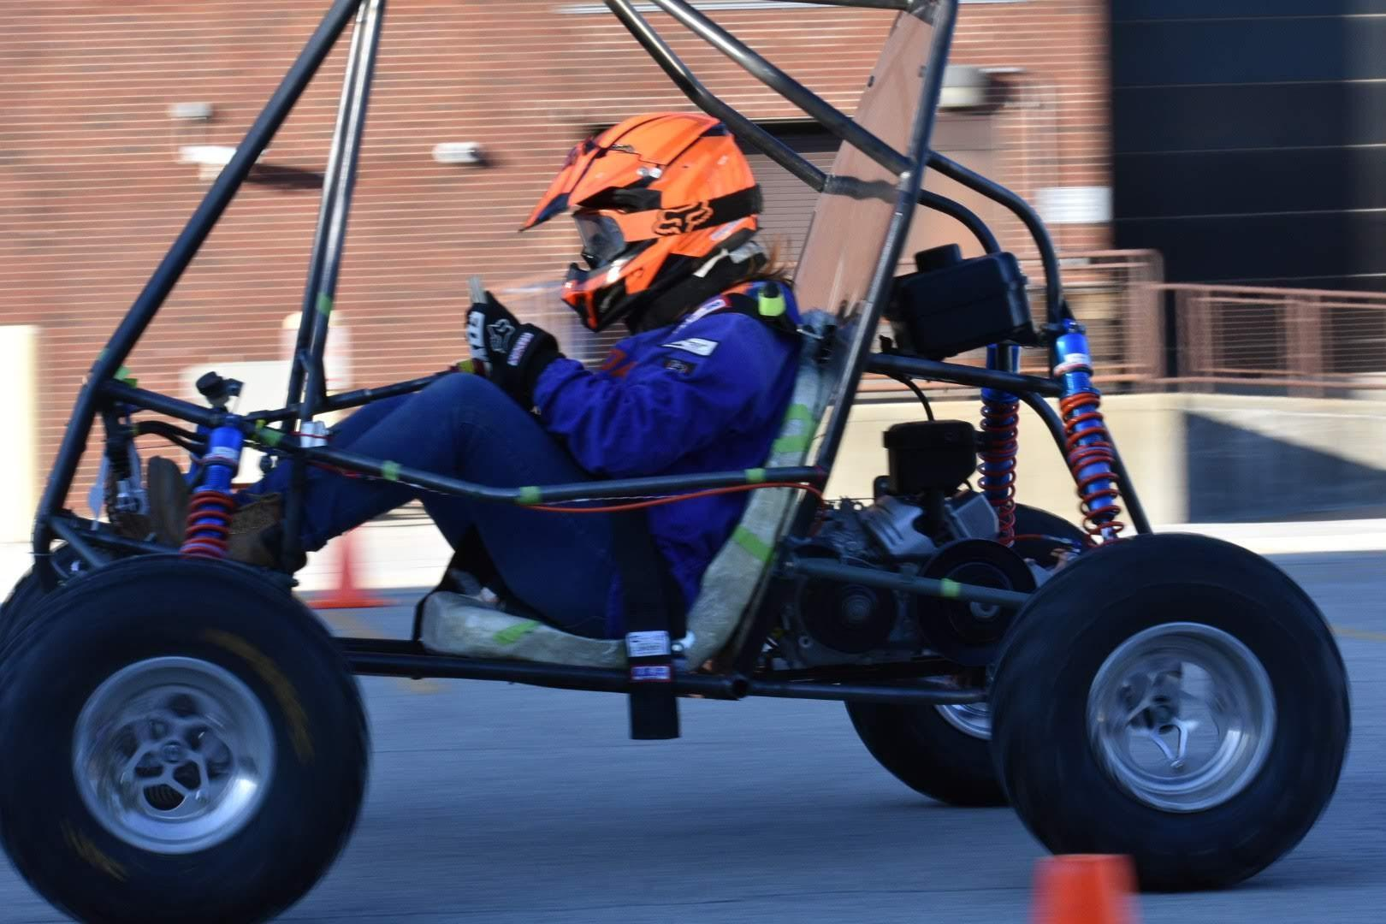
Chassis
Wednesdays at 7pm
Zoom Meeting
Fill out project interest form! Due today (4/13) at 3pm
Ideally we will assign projects this week
Wrapping up CAD for tab testing and the ramp redesign by next week
Sam will start leading subteam meetings this week
We will have a brief 4 wheel drive tech talk at our meeting this week!

Slide 8
Business
Tuesdays at 6:30pm
Zoom Meeting
Next Meeting: Tuesday 4/14
Fill out poll on what time you would like it to be and check in the channel for official time
Will be going over reflections from this semester and Josh will start talking about plans for next year

Slide 9
ME 199
04.13.20

Slide 10
General Updates
Design Report was submitted last Monday
Thanks to all that helped!
Work is continuing building simulations for 4WD validation

Slide 11
Subteam Meeting Times
General: Cancelled
Chassis/Suspension: Cancelled
Drivetrain: Cancelled
Aerodynamics: Cancelled
Tractive: Cancelled
DAQA: Cancelled
Mattermost channels will be up to date with any virtual meetings that take place!

Slide 12


MECHANICAL SUBTEAMS
CHASSIS
SUSPENSION
AERODYNAMICS
DRIVETRAIN
INTEGRATION

Slide 13
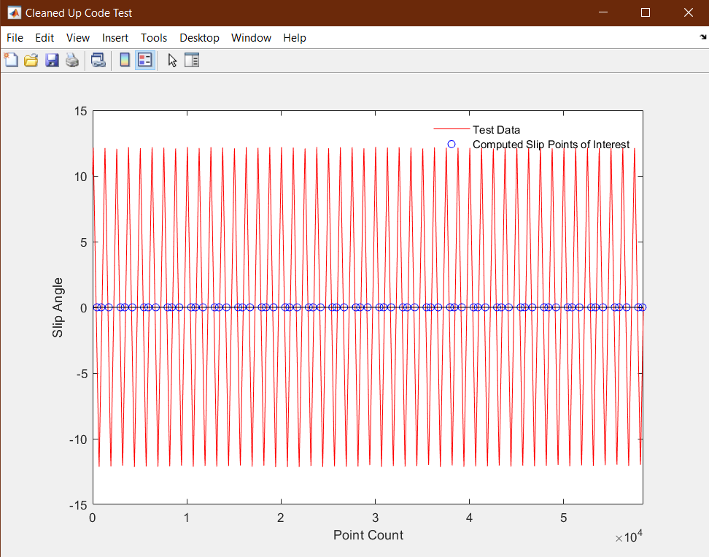
Chassis/Suspension
Kush Patel
kushrp2@Illinois.edu
Last Week
Finished design report
Had more detailed discussions on the execution of lap sims
Reevaluated ME199 projects
Worked on getting the TTC data working
This Week
Continue working on TTC Analysis
Create preliminary look up tables
Move towards modeling the magic formula
Develop preliminary bicycle car model for lap sims
Simplified cornering modeling
Move towards two track model
Begin looking at upright design and packaging in a 4WD car
Find more research projects to start on early

Slide 14
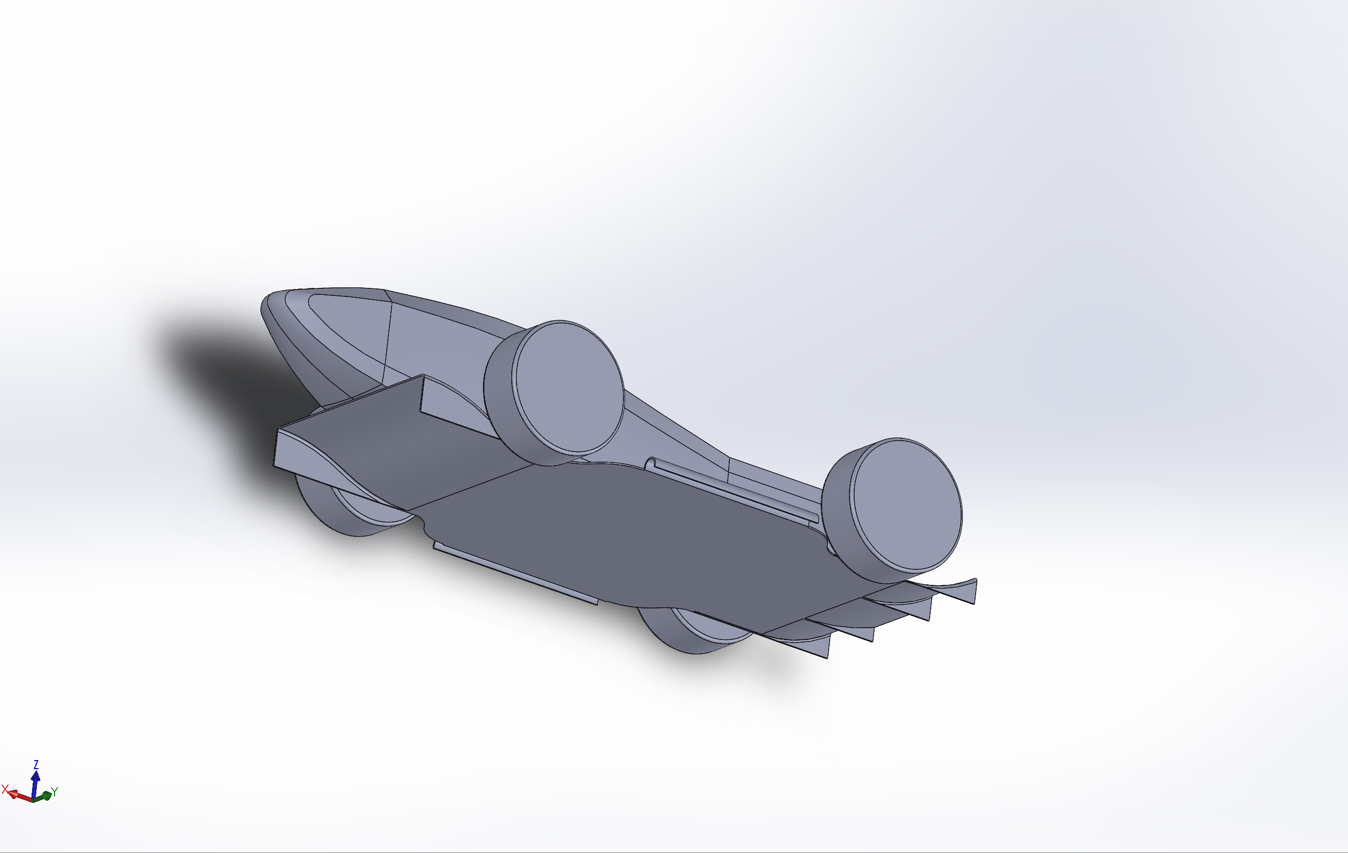
Aerodynamics
Carson Trpik
ctrpik2@illinois.edu
Last Week
Helped with aero in lapsim
This Week
Continue research for new aero components
Begin designing and testing
Set up server

Slide 15
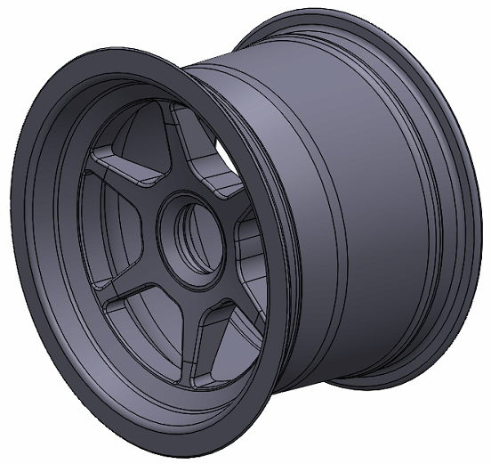
Drivetrain
David Lam
wj6@illinois.edu
Last Week
Modeled 10in OZ wheel for next year
Started 7.25:1 gearbox CAD in Solid works for research purposes
Started writing equations for gearbox design calculations
This Week
Finish 7.25:1 gearbox CAD

Slide 16
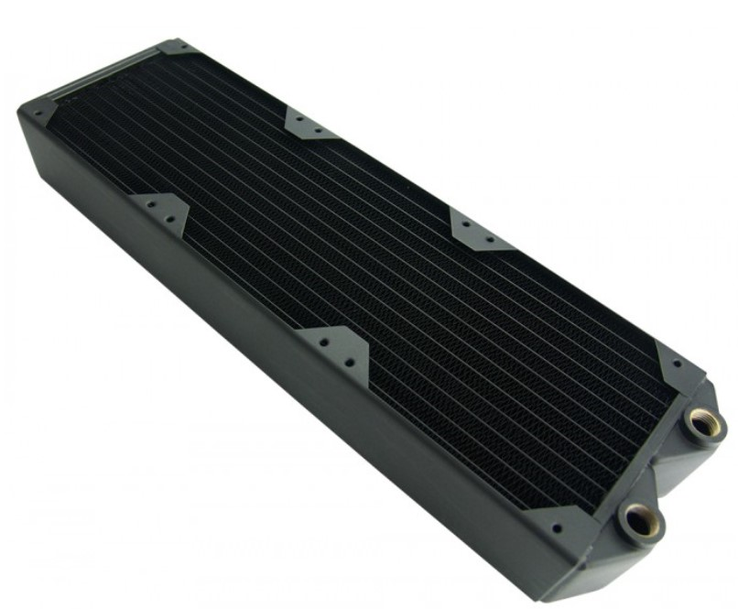
Integration
Rishi Taparia
taparia2@illinois.edu
Last Week
Found potential radiators
Reading about heat transfer
This Week
Figure out potential solutions for motor cooling

Slide 17


ELECTRICAL SUBTEAMS
TRACTIVE
DAQA
MOTORS
CONTROLS

Slide 18
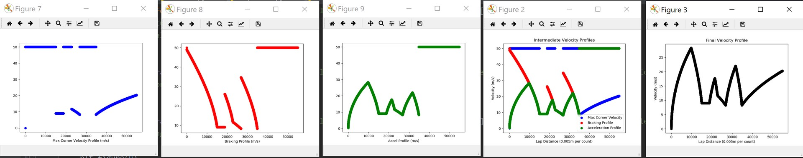
Tractive System
Evan Chen
evanc4@Illinois.edu
Last Week
Design report, spec sheet
Implement quasi-static simulator and mechanical modules
This Week
Lap Sim refinement

Slide 19
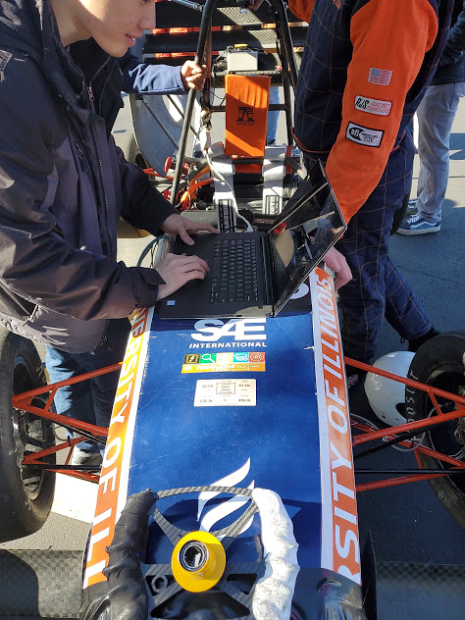
Data Acquisition
Joe Lopez
Joseal2@illinois.edu
Last Week
Sensor fusion trials from 2019 car data
Board redesign
This Week
Complete board redesign
Continue sensor fusion
Research web design best practices

Slide 20
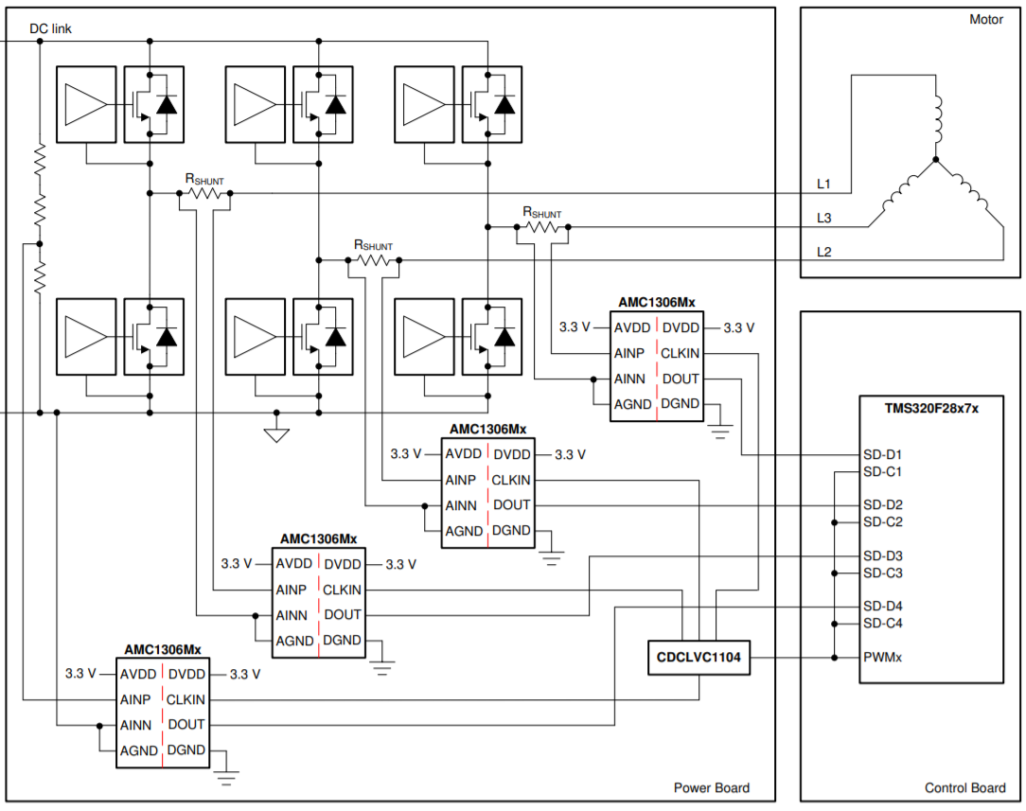
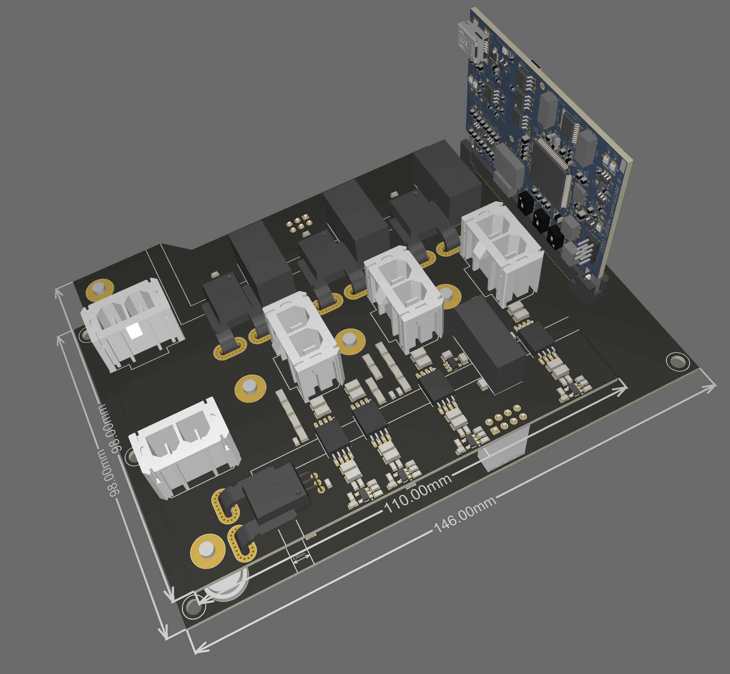
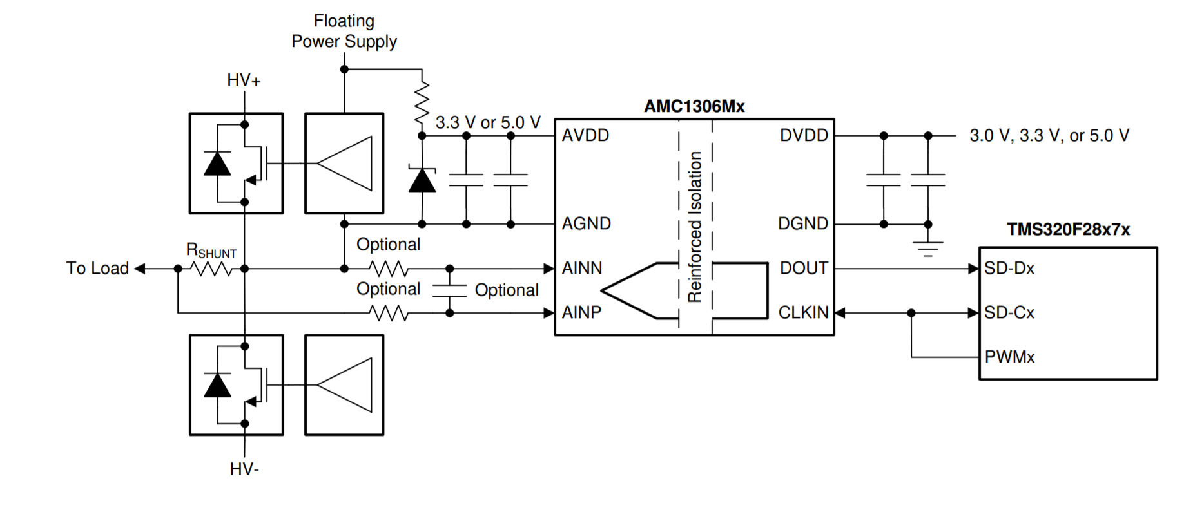
Motors/Controls
Chaitanya Sindagi
sindagi2@illinois.edu
Last Week
Board Layout 50% complete
This Week
Switch voltage and current sensing to Isolated Sigma Delta Modulators for noise immunity
Redo Output sensing layout
Confirm system architecture with industry professionals

Slide 21

BUSINESS SUBTEAM

Slide 22
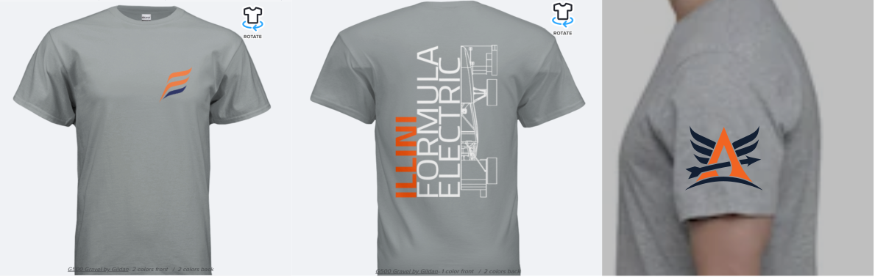
Business
Last Week
Researched information for business presentation
Sent out T-Shirt order form
This Week
Order is being placed today
Continue researching for business presentation
Create barebones presentation

Slide 23
QUESTIONS?

Slide 24
My time at Formula SAE
- Keyur Patel
ME199
4/13/2020

Slide 25
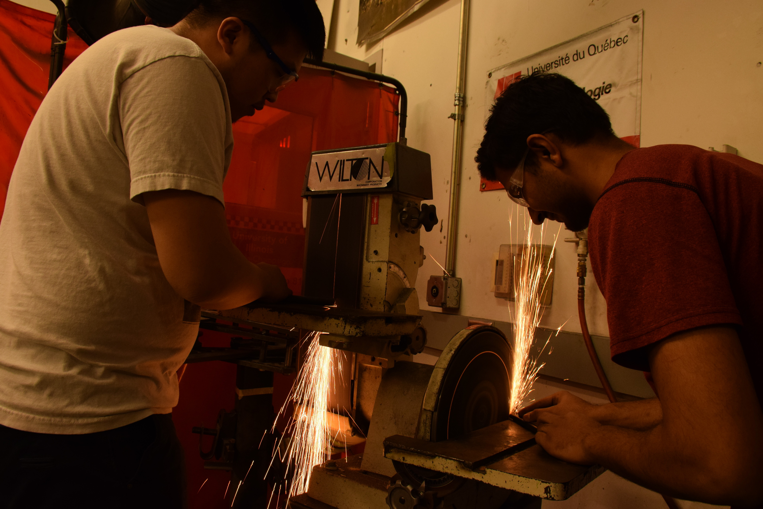
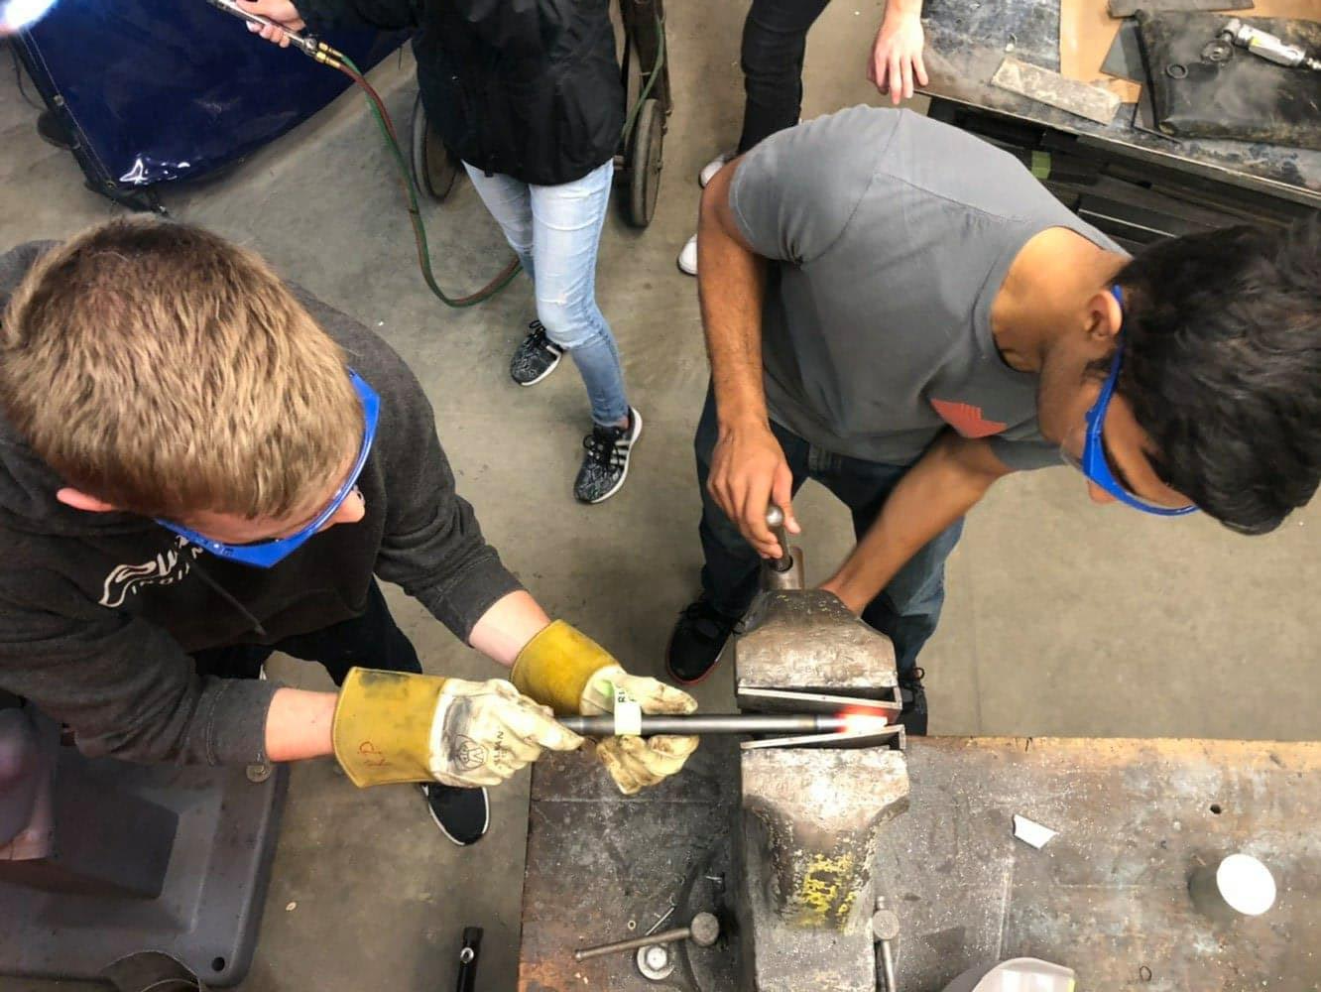
About me
Mechanical engineer 2022
Joined Illini Motorsports in Fall 2018
Suspension member 2018-2019
Project lead 2019-2020

Slide 26
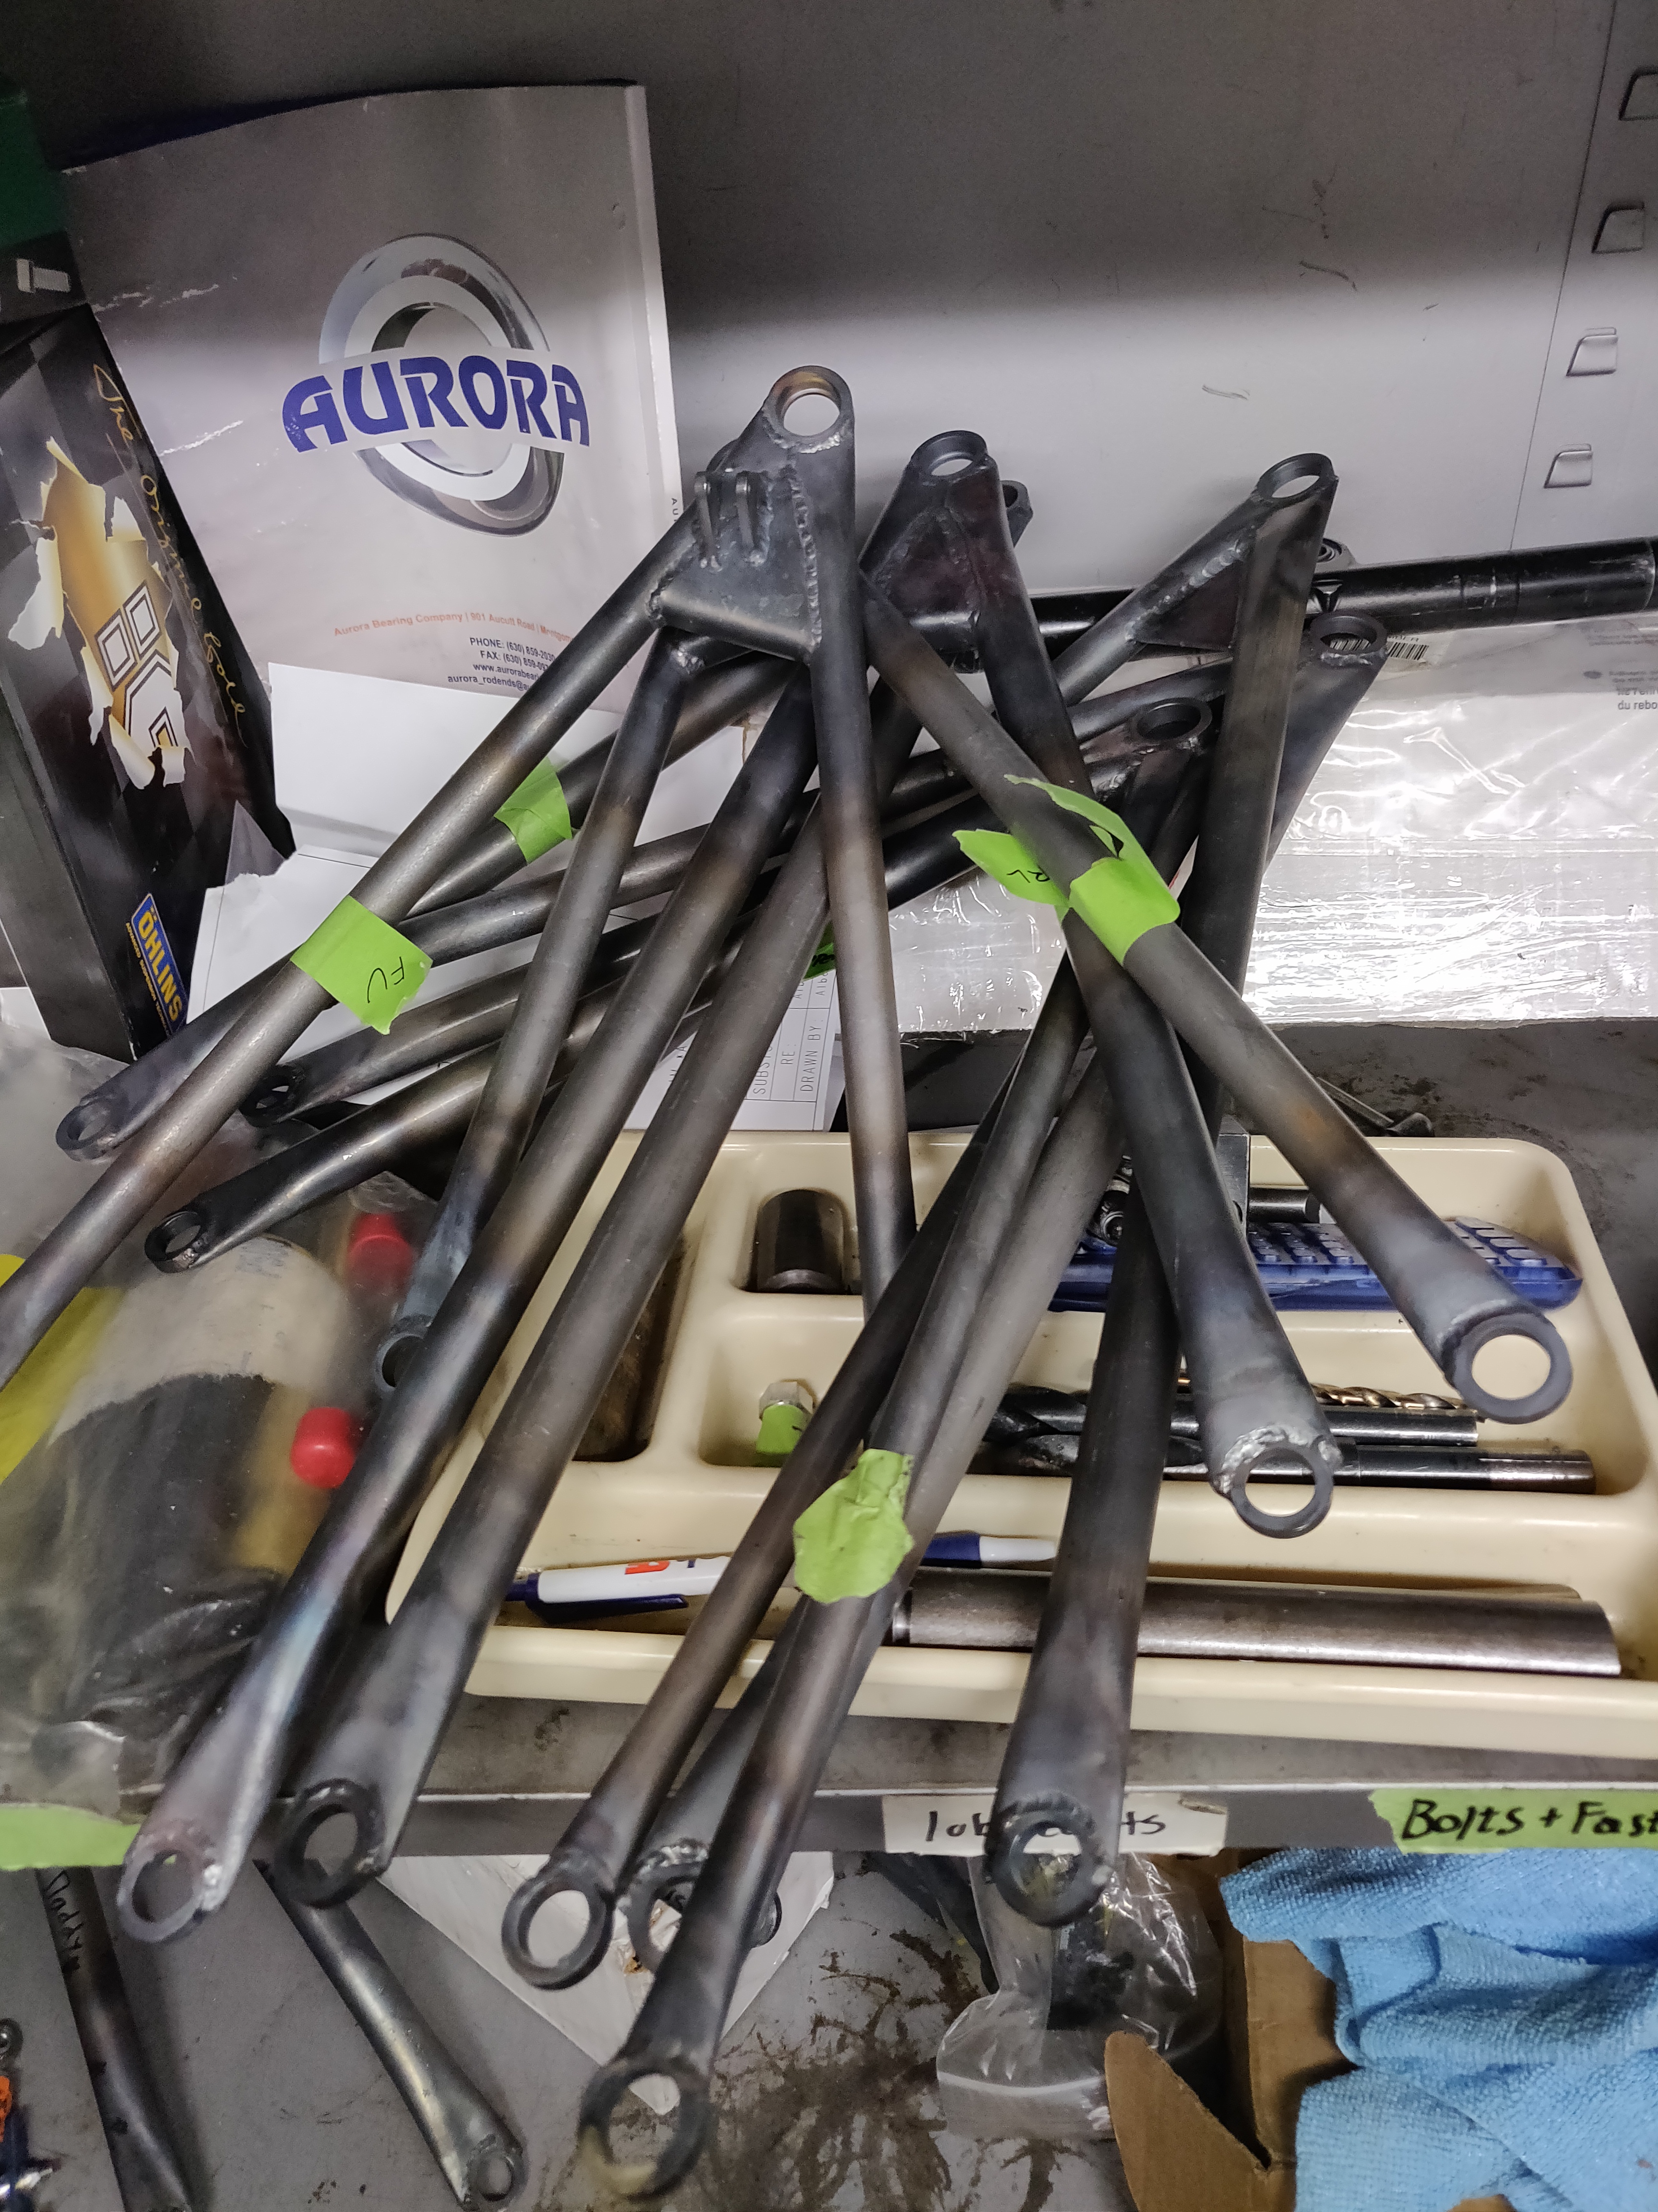
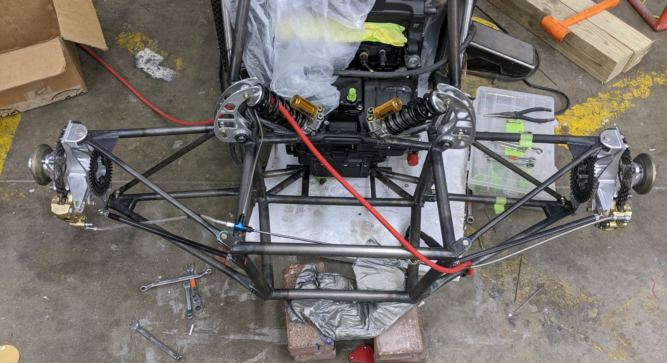
Contributions
Rolling Car assembly
Design Projects
A-arm sizing
Spherical bearing/rod end selection
A-arm manufacturing
Coordinating ARB manufacturing
Waterjet parts for all subsystems
Strain Gage mounting

Slide 27
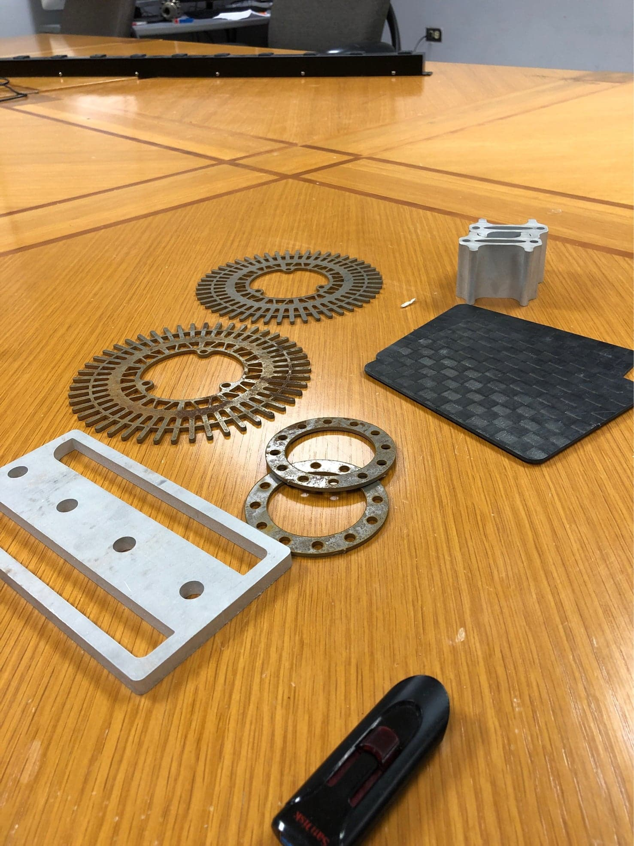
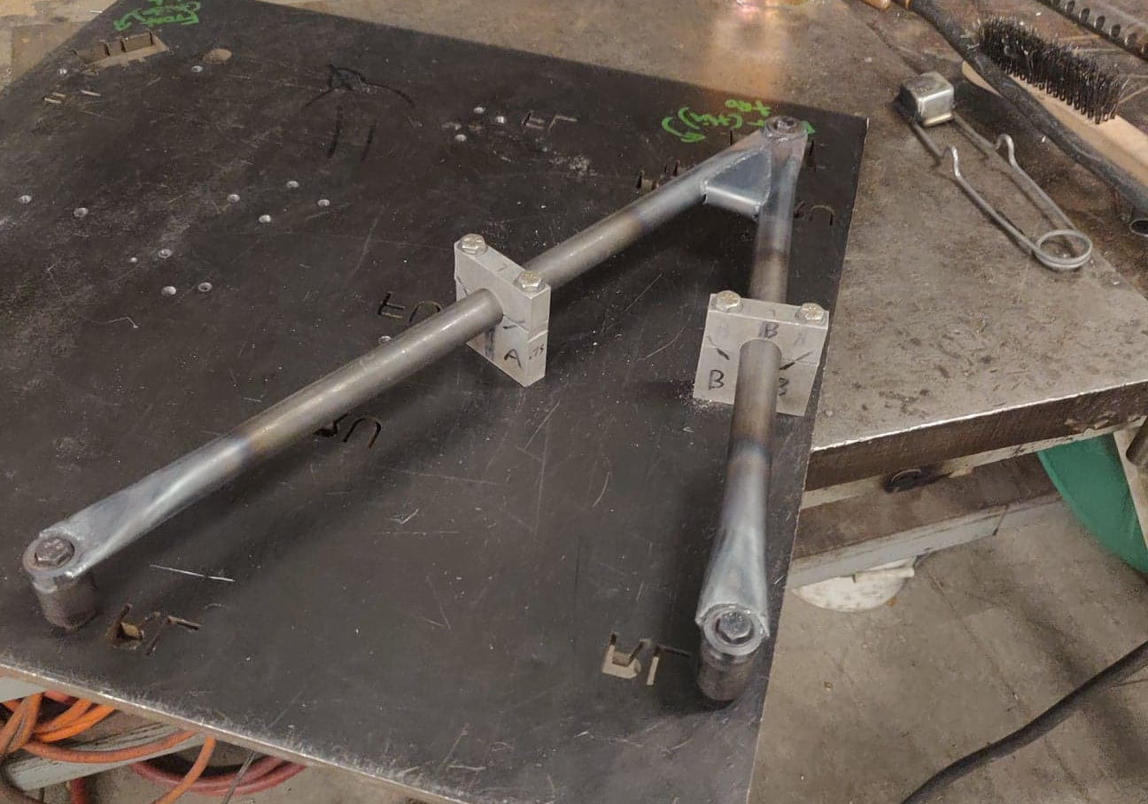
Technical Skills
Ability to communicate technical knowledge
Further developing software skills
Ansys
CREO
Matlab
Learning manufacturing
Waterjet
Lathe/mill

Slide 28
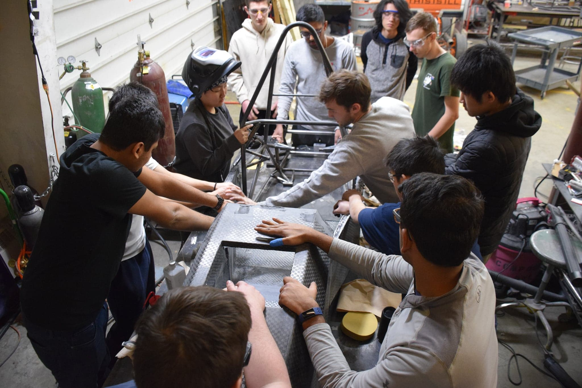
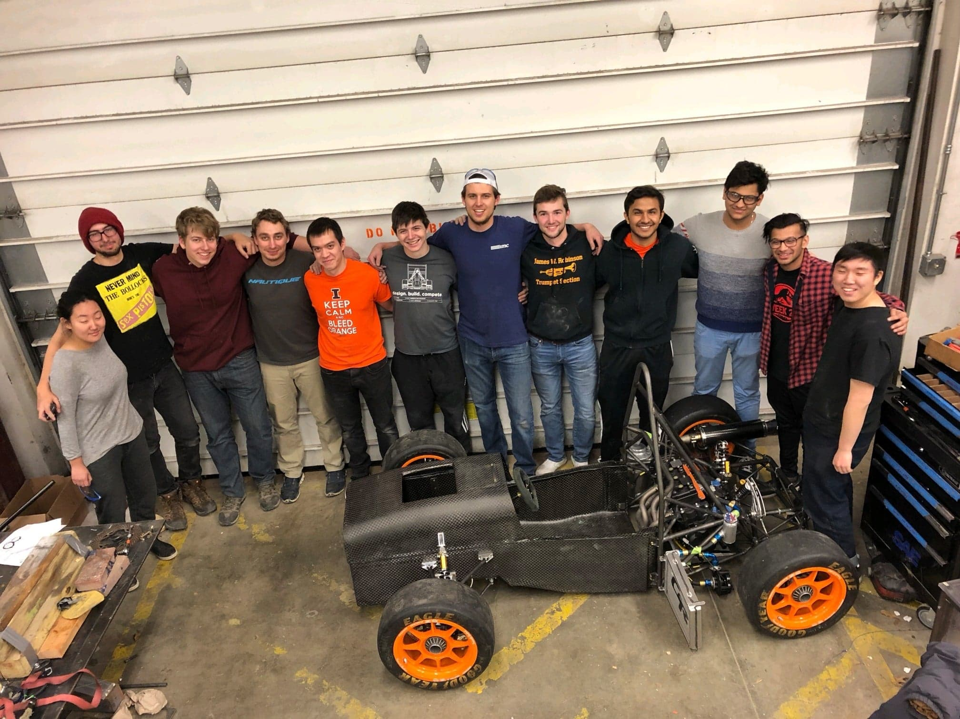
Community
I am grateful to be able to learn from such a talented group of engineers
Gained technical knowledge beyond classroom education
Opportunity to work with highly motivated students who push me past my limits

Slide 29
Ashish Mittal
Mechanical Engineering 2022
Joined Illini Motorsports in Fall 2018
Involvement
Engine Subsystem Lead 2020
Aerodynamics Member 2017-2018

Slide 30
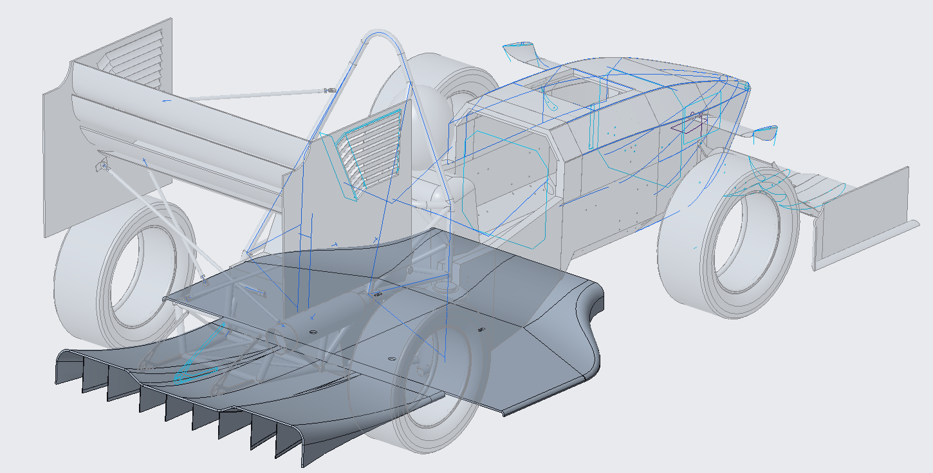
Aero Project Lead
Designed the underbody for 2020 car
Performed CFD analysis
Sandwich panel testing on Instron
FEA
Carbon fiber layup and post processing

Slide 31
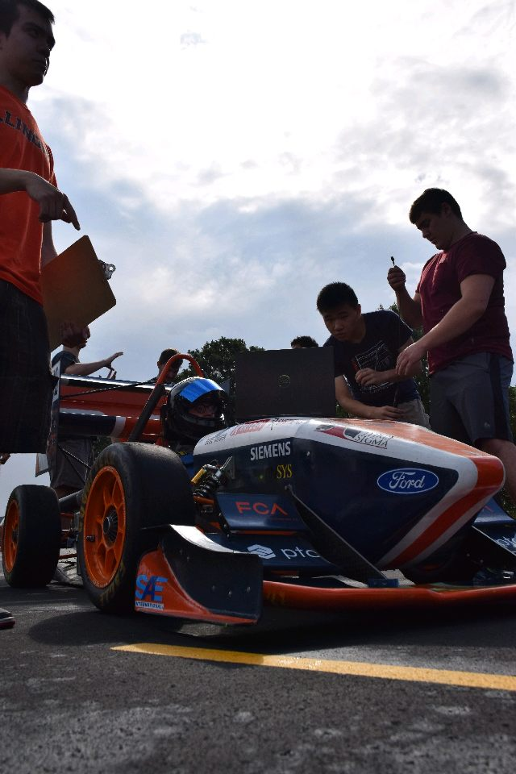
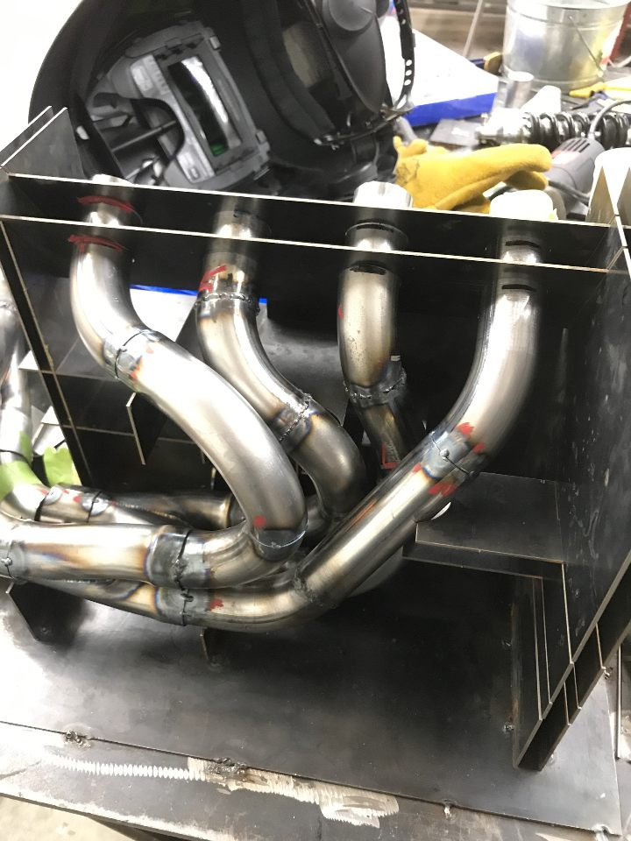
Engine Team Lead
Helped manufacture exhaust system
Helped with Engine Tuning
Helped in assembly and engine startup

Slide 32
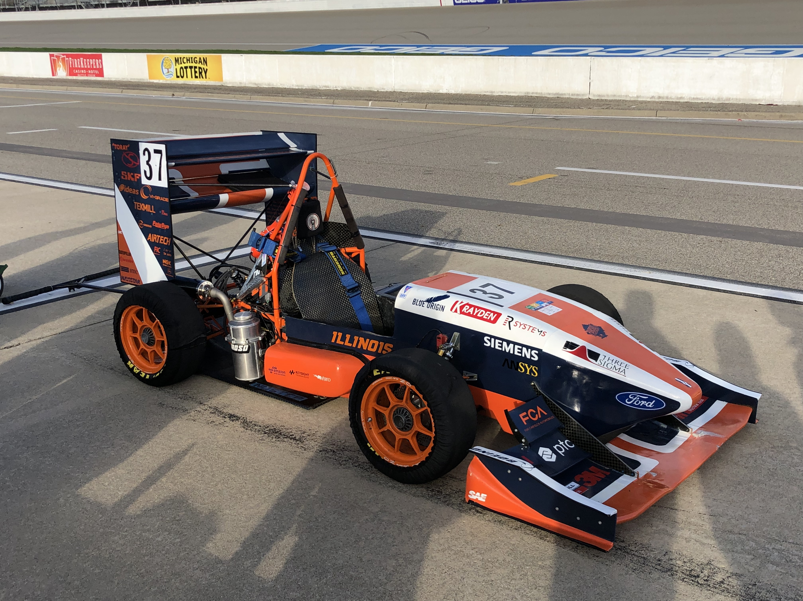
General Teamwork
Sanded the aero package
Layups for various parts across subsystems
Instron panel testing
CNC mold machining
Restrictor CFDa
Worked on the Carbon Fiber Panels property prediction model

Slide 33
Anuj Soni
Mechanical Engineering 2023
Joined Illini Motorsports in Fall 2019
Drivetrain Subsystem Member

Slide 34
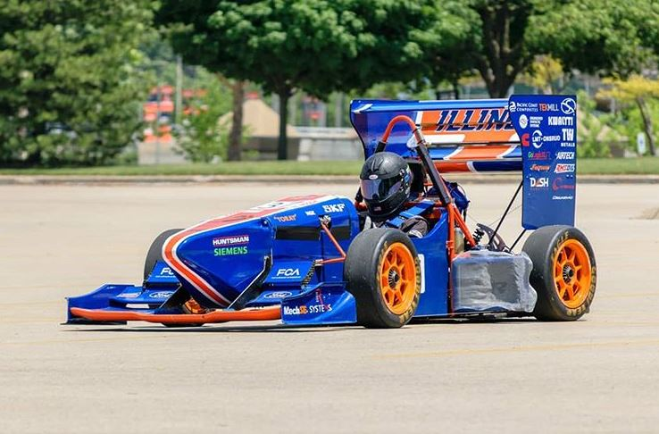
Involvement as a Drivetrain Member
Helped bleed the brakes multiple times in time for rolling car
Help with various tasks for drivetrain
Help clean the team room
Help dismantle brake assemblies

Slide 35
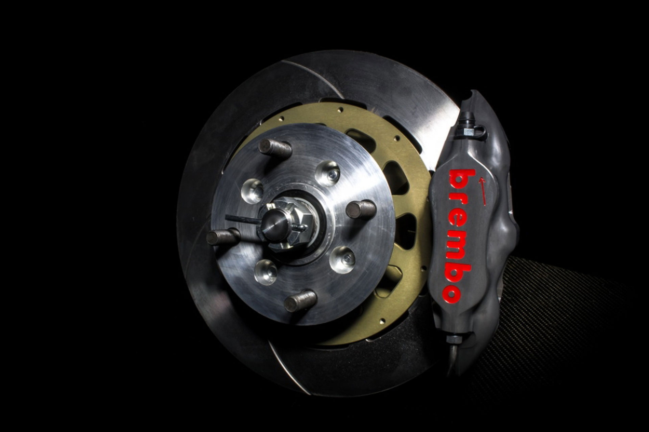
Knowledge Learned
How the drivetrain works
How ABS works and how it can be beneficial
How to bleed brakes and why it is important to not have any air in the lines

